Slide 1
Studying Explain-ability and Comparing GNN models for the task of link prediction
Presentation by: Abdullah Khan

Slide 2
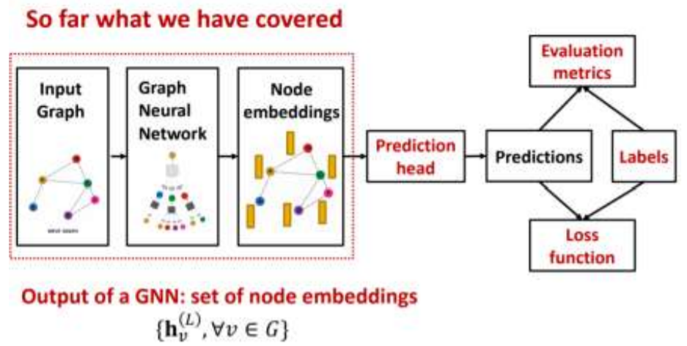
Link Prediction

Slide 3
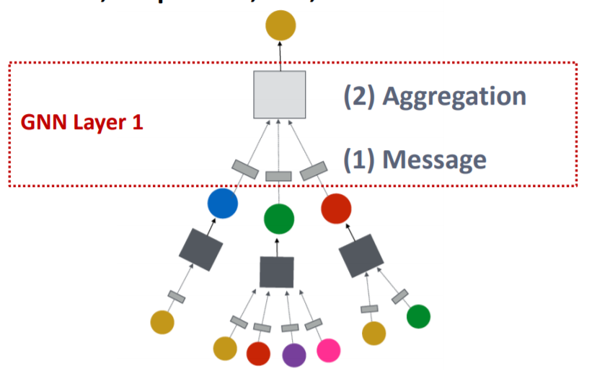
Message Passing

Slide 4
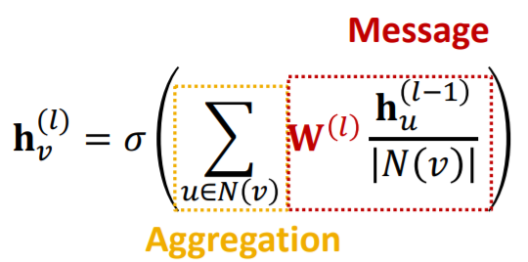
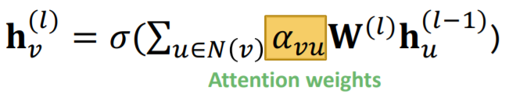
GNN Models
Graph Convolution Network (GCN)
Graph Attention Network (GAT)
Trainable Attention Weights

Slide 5
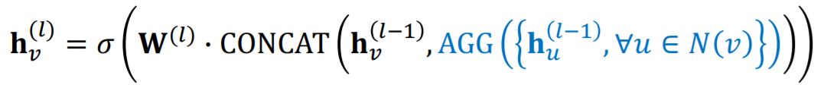
GNN models Contd.
Graph SAGE
Concatenation of self embedding
Normalization after each step

Slide 6
Comparative Analysis
Comparative Analysis of various GNN models
Performance measure: AUC ROC, AP, Recall
Datasets
Cora: 2708 nodes, 5429 links, sparse, low avg. node degree, larger diameter
PubMed: 19k nodes, 44k links, dense, higher avg. node degree, smaller diameter

Slide 7
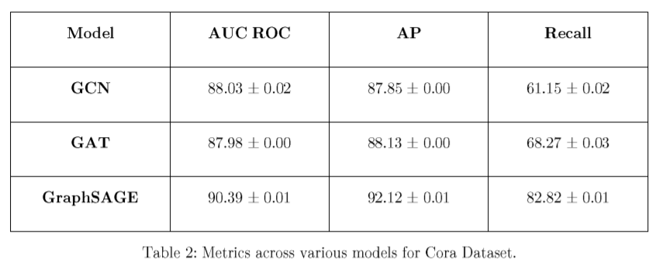
Results
AUC ROC & Precision
score are similar
Recall shows that GraphSAGE
performs better.
GraphSAGE is better at predicting
actual links.

Slide 8
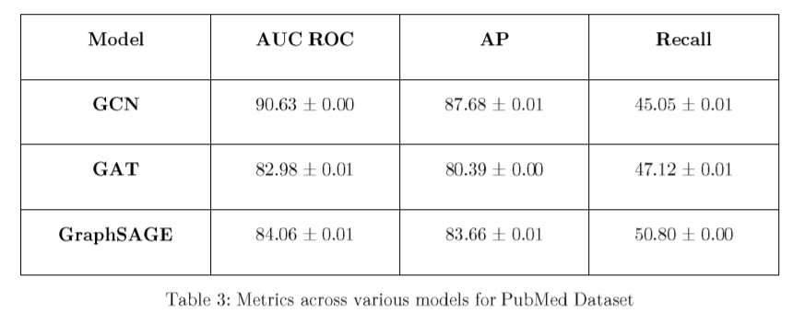
Results contd.
Dense graphs tend to be computationally more intensive
GCN : least taxing model performs well.
GraphSAGE again performs better in predicting actual links

Slide 9
Future Work
Both the datasets are relatively small. Need to experiment the same for larger graphs
There exists relations between nodes based on edge types.
Dense graphs are computationally intensive. We intend to apply some scaling techniques to reaffirm our results.

Slide 10
Progress since mid term
Effect of Parameterized Decoders
Inner Product*
Rescal
Dedicom
Directed Dedicom
Explanations for certain link predictions
Computationally important Subgraph
Most important features

Slide 11
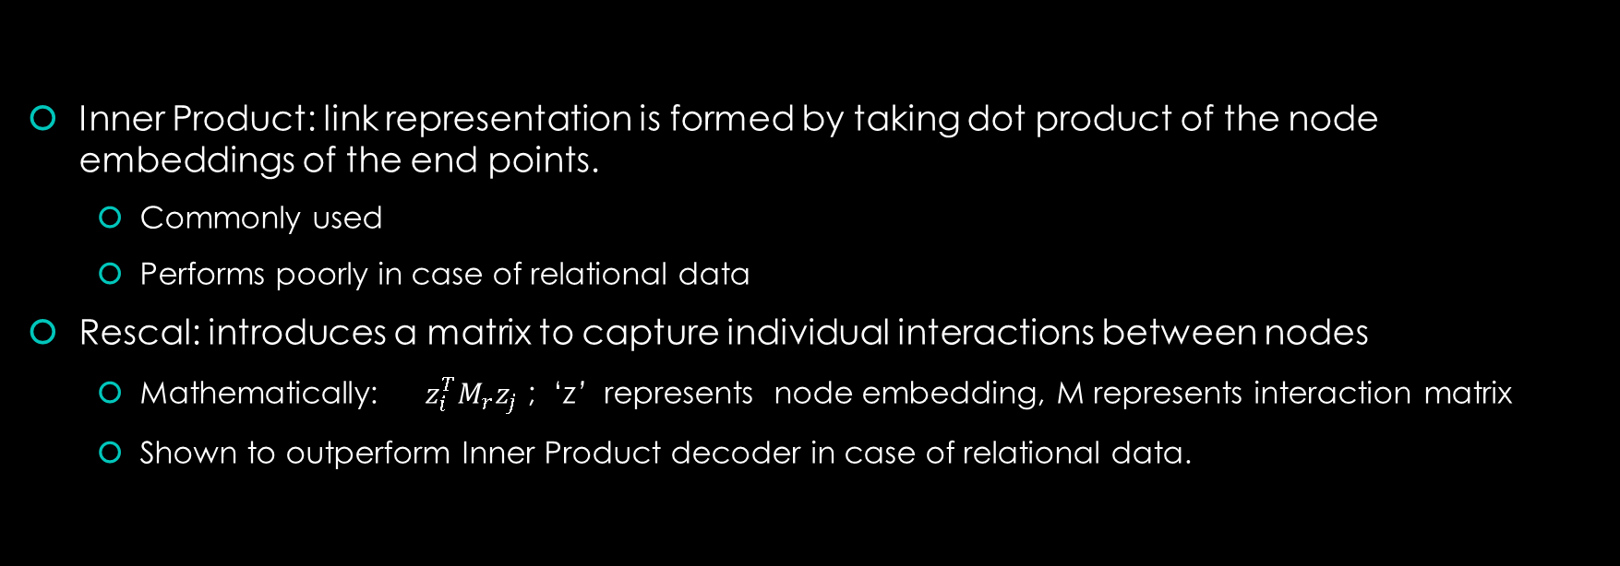
Decoders
Inner Product: link representation is formed by taking dot product of the node embeddings of the end points.
Commonly used
Performs poorly in case of relational data
Rescal: introduces a matrix to capture individual interactions between nodes
Mathematically: $z_{i}^{T}M_{r}z_{j}$ ; ‘z’ represents node embedding, M represents interaction matrix
Shown to outperform Inner Product decoder in case of relational data.

Slide 12
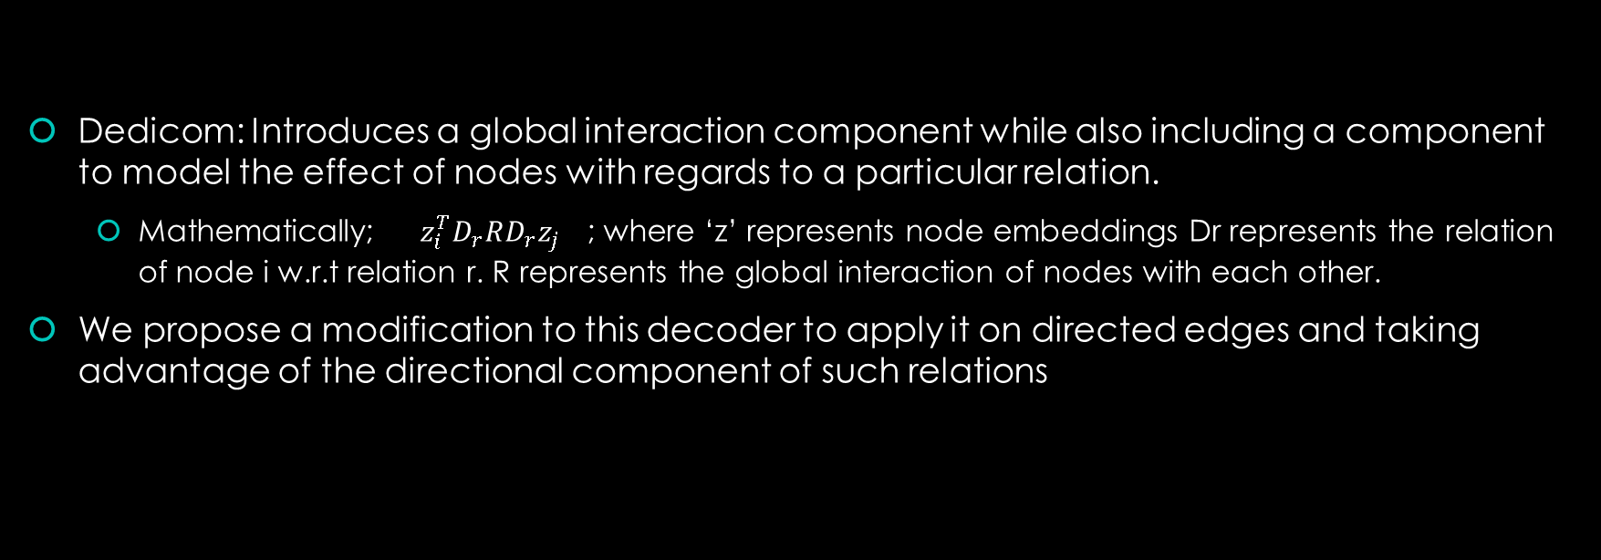
Dedicom
Dedicom: Introduces a global interaction component while also including a component to model the effect of nodes with regards to a particular relation.
Mathematically; $z_{i}^{T}D_{r}RD_{r}z_{j}$ ; where ‘z’ represents node embeddings Dr represents the relation of node i w.r.t relation r. R represents the global interaction of nodes with each other.
We propose a modification to this decoder to apply it on directed edges and taking advantage of the directional component of such relations

Slide 13
Observations
In our preliminary testing on the same datasets used before, these parameterized decoders perform equally well as Inner Product
This was expected since those datasets do not have a relational component.
The performance of these parametrized decoders depend upon the size of node embeddings being produced. Since a lower dimension embedding will have lost most of its information already.
Lower dimensionality of node embeddings do not affect Inner Product decoders in a significant manner.

Slide 14
Need for parametrized decoders
Most of medical datasets have multiples types of node representing different types of entities.
Knowledge graphs usually have multiple relations.

Slide 15

Explanations
Finding a minimal subgraph in the computation graph, that minimizes the difference in the prediction scores using the whole computation graph and the minimal graph.
Subset of node features that were most influential in the decision process.
Finds edge mask and feature mask based on the above loss function.

Slide 16
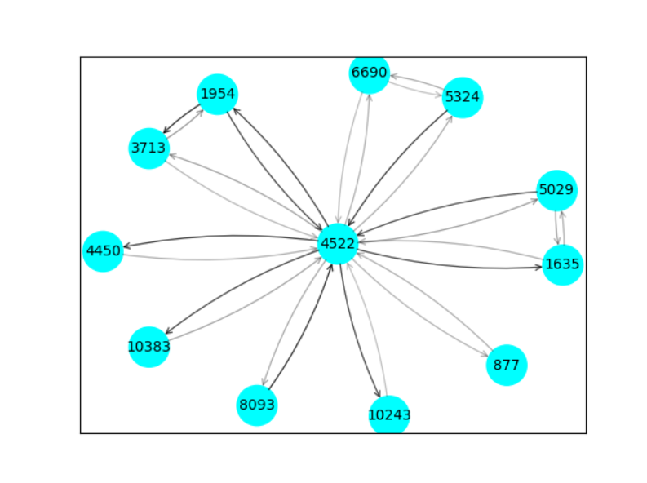
Example of minimal subgraph

Slide 17
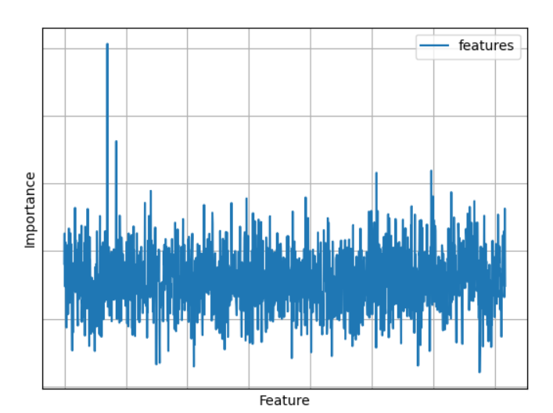
Subset of features
The presence of these important features in both the nodes are responsible for presence of a link between them

Slide 18
Future Work
Presentation of this information in a more interpretable manner
The subgraph is only for 1-hop neighborhood for illustration purposes. However the model usually takes 2-hops to form the computation graph
Evaluating the accuracy of these explanations

Slide 19
Applications
Explaining anomalous links in the input graph.
Potentially, Removal of noisy features from the nodes for better performance in downstream tasks

Slide 20
Thank You
Any Queries?

